Slide 1
Squares and Square Roots
Grade 8- Chapter 3

Slide 2
Practice Problems

Slide 3
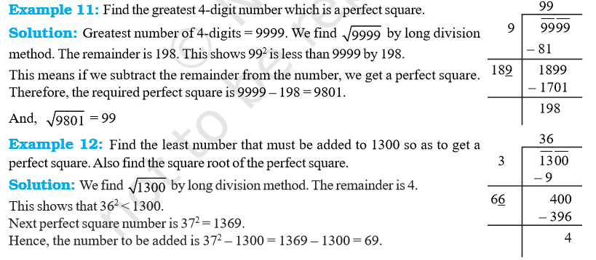

Slide 7
